Slide 1


Final Year Project
SpotCancerAI
Smart Skin Cancer Detection System
Supervised By: Mr Hafiz Haseeb

Slide 2
Project Team
Muhammad Usman (24761)
Hassan Dastagir (40124)
Ali Sher Khan (39917)

Slide 3
Table of Content
Introduction and Background
Literature Review and Summary Table
Problem Statement
Methodology
Market Survey
Progress Report Summary
  Requirements
  Software System (Design + Implementation + Testing)
  Endeavour (Team)
Next Steps
Prototype / Report

Slide 4
INTRODUCTION AND BACKGROUND

Slide 5
Introduction and Background[1/2]
This project develops an AI-based model using deep learning to automatically detect and classify skin lesions from dermoscopic images. The AI-based model aims to accurately identify skin cancer types, such as melanoma, basal cell carcinoma and squamous cell carcinoma. The goal is to improve diagnostic accuracy and efficiency, supporting early skin cancer detection and assisting healthcare professionals in medical decision-making.

Slide 6
Introduction and Background[2/2]
Skin cancer is a major global health concern, with early detection being crucial for effective treatment. Traditional diagnostic methods such as visual examination by dermatologists, dermoscopy and skin biopsies, are often time-consuming, subjective, and require expert analysis. These limitations highlight the need for artificial intelligence (AI) to provide faster, more accurate, and automated skin cancer detection, improving early diagnosis and treatment outcomes.

Slide 7
Literature Review and Summary Table
References | Deep Learning techniques | Dataset | Accuracy
[1] | Applied MobileNet architecture | HAM10000 | 85%
[2] | Utilized VGG16 and Streamlit | Private collected dataset | 86%
[3] | k nearest neighbors model | Population-based Australian cohort study | 91%
[4] | federated learning system | ISIC2019 | 90%
[5] | Developed a deep learning system for differential diagnosis of 26 common skin conditions | Teledermatology | 66%
[6] | Implemented CNNs with Flask | ISIC | 90%
[7] | CNN models implemented with TensorFlow Lite | Seven classes on a combined dataset | 74.27%
[8] | EfficientNetB1 and EfficientNetB5 architectures | HAM10000 | 93%
I reviewed 15 research papers on Skin Cancer Detection, including 8 recent papers (2022–2024). These focused on deep learning techniques, diagnostic accuracy, and clinical applications, helping me understand current trends and challenges in the field.

Slide 8
Problem Statement
Skin cancer is one of the most common and deadly cancers worldwide. Early and accurate detection greatly improves survival rates. However, traditional diagnosis is slow, subjective, and depends on specialists. Limited access to dermatologists causes delays, especially in remote areas. Current AI tools lack accuracy and may not work well for diverse skin tones, highlighting the need for a reliable, accessible AI-based detection system.

Slide 9
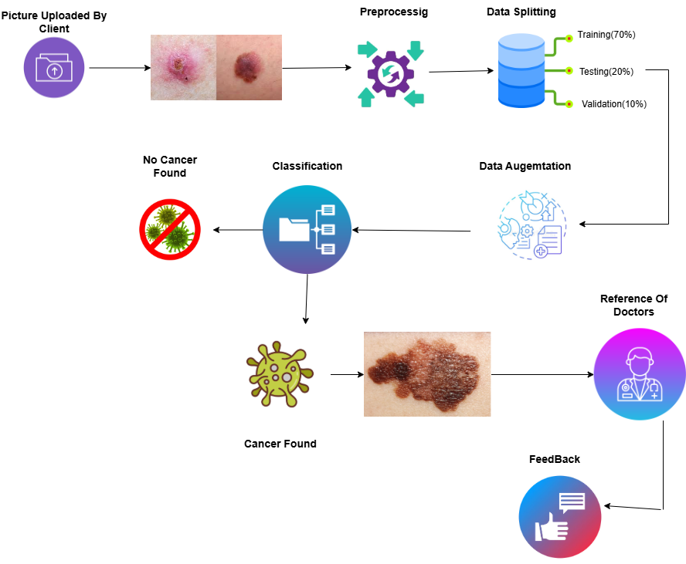
Methodology

Slide 10
Market Survey
Application | Technique | Test Set | Remarks
SkinVision App | Conditional generative adversarial neural network (segmentation) and SVM (classification) | ~black‑white melanoma photos → sensitivity 73%, specificity 83%, | CE‑marked; performance drops in real‑world lesions
SpotMole | Image processing techniques, ABCDE rule (Asymmetry Border Color Diameter Evolution) | 1 melanoma + 41 suspicious lesions (same Brisbane dataset): sensitivity 43%, specificity 80% | Low sensitivity (missed >50% melanomas); no recent updates, likely discontinued
Dr Mole | Algorithm based on the ABCDE rule (Asymmetry Border Color Diameter Evolution) | Same test set: 1 melanoma + 41 lesions → sensitivity 21%, specificity 100% | Only 1 malignant melanoma was Found
Lubax | Content-based image retrieval, k-nearest neighbor | 208 lesions with melanoma^{d} | Algorithm tested only on malignant melanoma (large lesions only)

Slide 11
PROGRESS REPORT
SUMMARY

Slide 12
Requirements(1/3)
1.List Of Different Users:
patient
Dermatologist
Admin
2.Functional Requirements:
Five Functional Requirements.
3.Non_Functional Requirements:
Six Non_Functional Requirements.

Slide 13
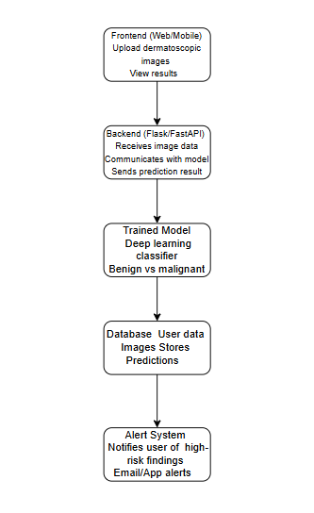
Design

Slide 14
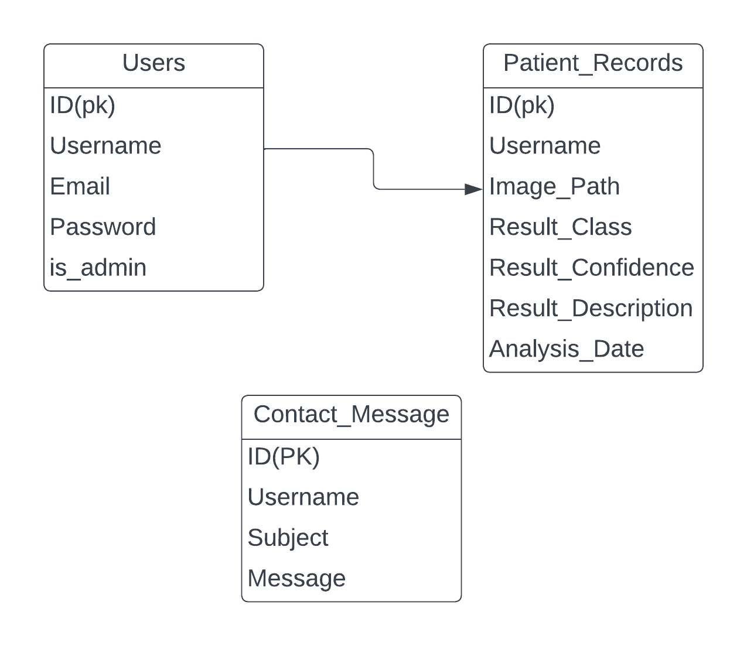
Design
ERD DIAGRAM:

Slide 15
Implementation[1/3]
List Development Tools & Technologies
Frontend: HTML , CSS
Backend: Flask
Database: SQL Lite
Programming Languages: Python
Machine Learning: TensorFlow, OpenCV
Version Control: GitHub (for collaboration version control and automation).
List Best Practices / Coding Standards
List Libraries / Components / Web Services

Slide 16
Implementation[2/3]
List Libraries / Components / Web Services
Frontend Libraries:
Next.js: for building dynamic user interfaces and server-side rendering and optimized frontend performance.
React-Toastify: For customizable notification alerts.
Framer Motion: For animations and transitions in the dashboard.
Backend Libraries:
FastAPI: Framework for creating APIs.
SQLAlchemy: ORM for database management.
Uvicorn: ASGI server for FastAPI.
Python-Jose: For secure JWT-based authentication.

Slide 17
Implementation[3/3]
List Libraries / Components / Web Services
Frontend Libraries:
HTML
CSS
Jinja 2
Backend Libraries:
Flask
SQL Lite
Python

Slide 18
Implementation[3/3]
Machine Learning Libraries:
TensorFlow
OpenCV
Utilities and Other Tools:
Pandas
Numpy
ImageDataGenerator

Slide 19
ENDEAVOUR

Slide 20
Endeavour(1/2)
Hassan Dastagir:
Model Training
BackEnd
Documentation
Ali Sher Khan:
Model Training
Fine Tuning
Front End Designing & Development
Muhammad Usman:
Model Training
Documentation

Slide 21
Endeavour(2/2)
software development process
Requirements Gathering & Analysis
Preprocessing & Data Management
Data Splitting & DataFrames
Augmentation
Model Design & Architecture
Training & Testing
Implementation & Integration (Flask WebApp)

Slide 22
NEXT STEPS

Slide 23
Work Breakdown Structure
Project Planning & Setup
  Define Project goals and scope.
  Select Technologies and frameworks.
  Create Initial Project Timeline.
Data Collection & Preprocessing
  Collect Dataset From Kaggle (HAM10000).
  Preprocess images(resize,gaussian blur, inpaint etc)
  Split data into Train (70%),Testting(20%),Validation(10%). . .
  Perform Data Augemtation (Brightness range,shear_range ,Zoom_range etc).
Website Development
  Create Flask Dashboard(login,signup ,Forgotpassword,).
  Design User Interface(Home,Analyze,contact,patient_records,Profile logout).
  Admin Interface(Admin Dashbaord)..
Testing & Validation.
Final Optimization.
Maintenance & Documentation.
Mobile Application.

Slide 24
Challenges
Resources
Class Imbalance
Model Overfitting
Model Integration
Train Model On Different CNN Architecture

Slide 25
PROTOTYPE & REPORT

Slide 26
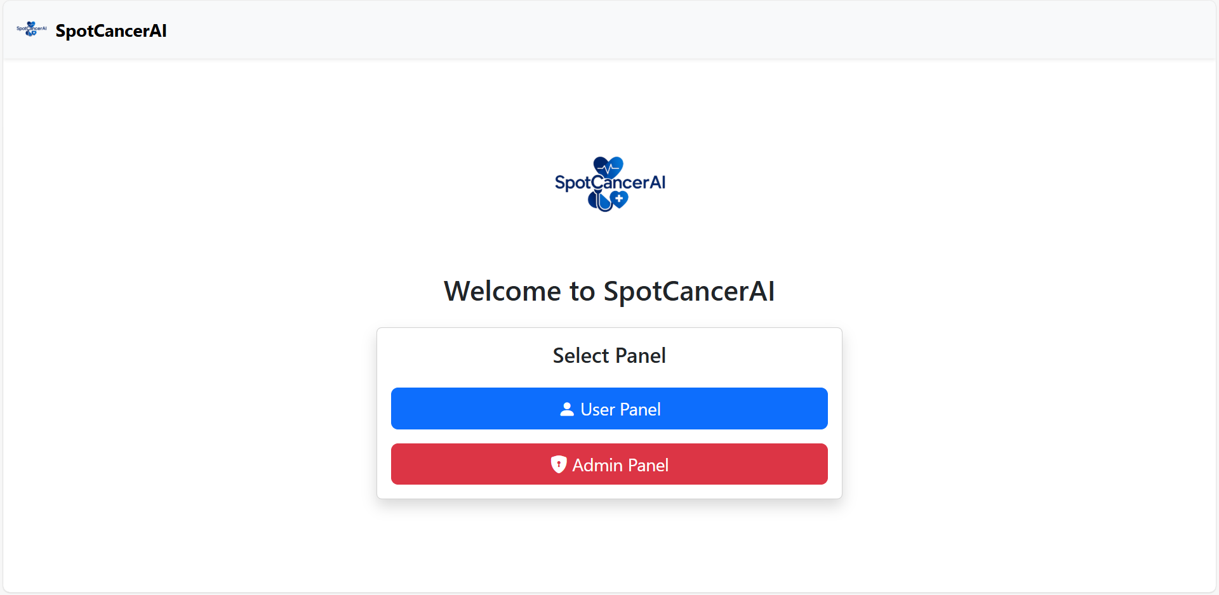
Prototype

Slide 27
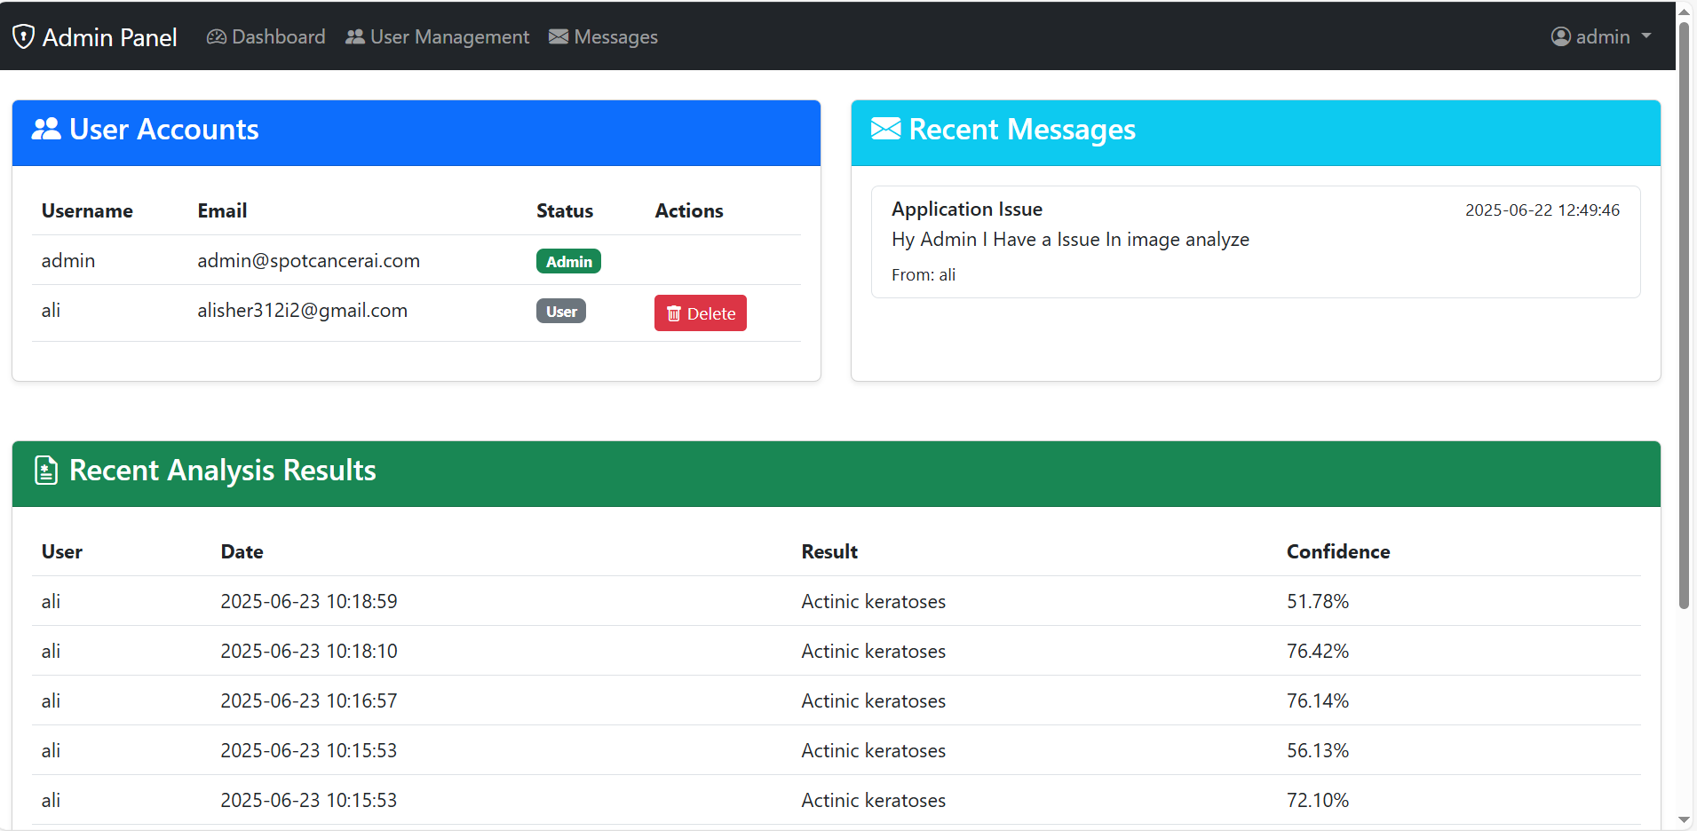
Prototype

Slide 28
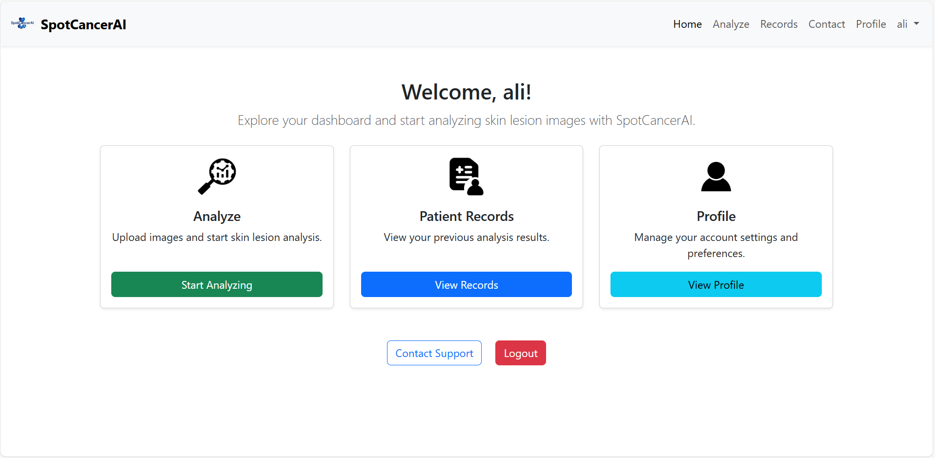
Prototype

Slide 29
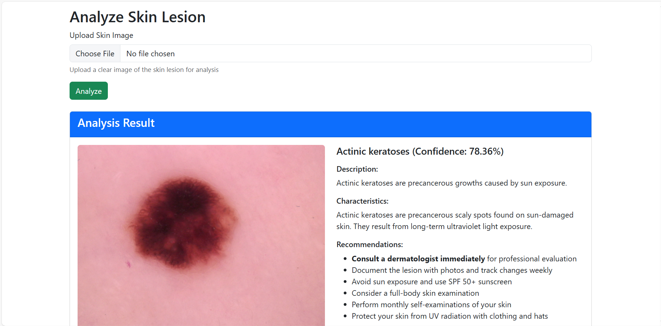
Prototype

Slide 30
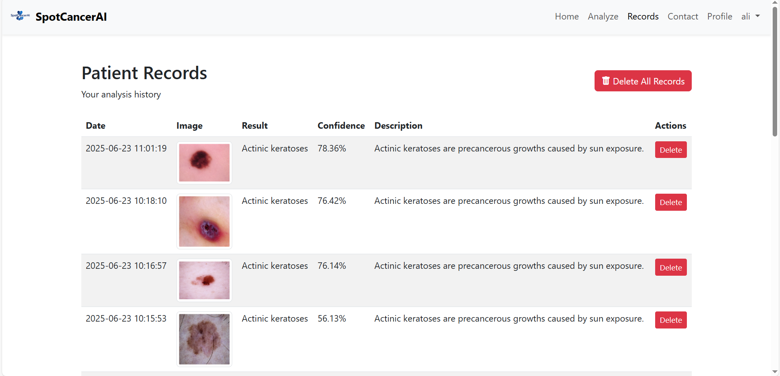
Prototype

Slide 31
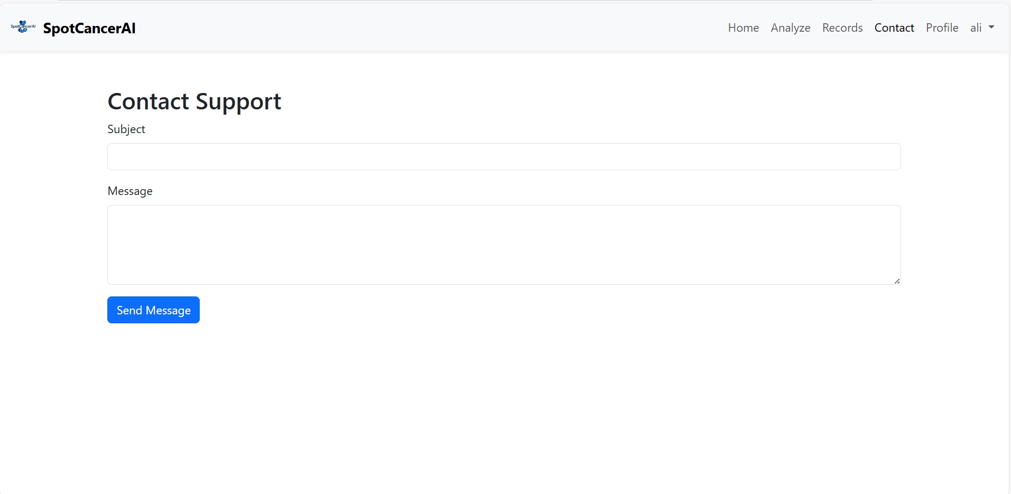
Prototype

Slide 32
Report
Chapter 1: Introduction
Chapter 2: Literature Review / Market Survey
Chapter 3: Requirements and Design
Chapter 4: Implementation and Test Cases
Chapter 5: Experiment Results and Analysis
Chapter 6: Conclusion & Future Direction

